Slide 1
Lecture 29 : Introduction to Generative Adversarial Networks (GANS)

Slide 2
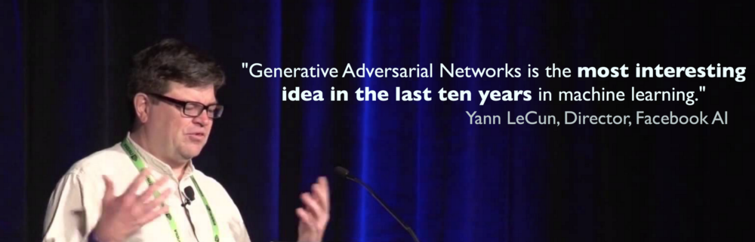

Slide 3
Outline
Generative Modeling Motivation
High Level Formalism
Architecture
Mathematics
Training GANS
Conditional GANS

Slide 4
Outline
Generative Modeling Motivation
High Level Formalism
Architecture
Mathematics
Training GANS
Conditional GANS

Slide 5

Unpaired Image-to-Image Translation using Cycle-GANs
[Zhu et al. 2017]

Slide 6
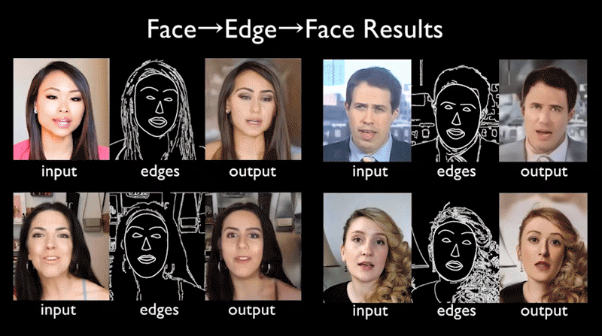
Video-to-Video Synthesis
[Wang et al. 2018]

Slide 7
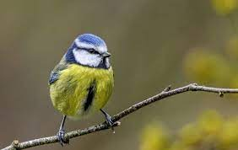
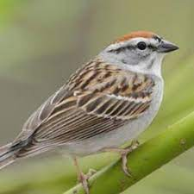


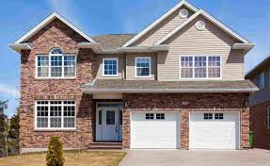
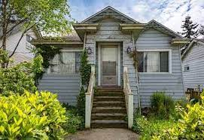
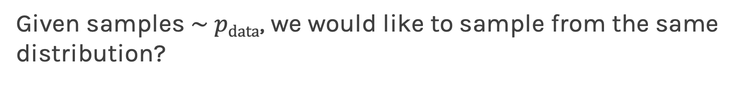
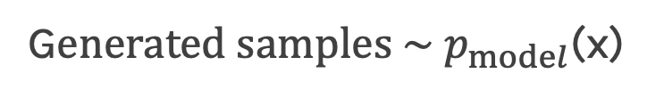
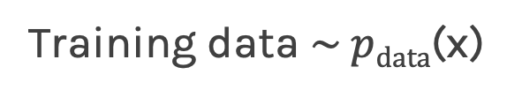
What is generative modeling?
Given samples $\sim pdata$, we would like to sample from the same distribution?
Training data $\sim pdata$(x)
G$enerated samples \sim p_{model}$(x)

Slide 8
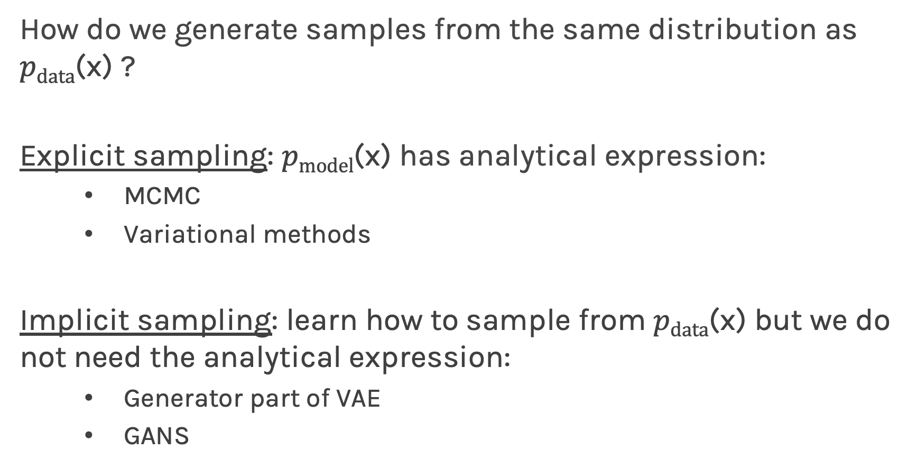
What is generative modeling?
How do we generate samples from the same distribution as $pdata$(x) ?
Explicit sampling: $pmodel$(x) has analytical expression:
MCMC
Variational methods
Implicit sampling: learn how to sample from $pdata$(x) but we do not need the analytical expression:
Generator part of VAE
GANS

Slide 9
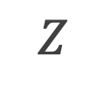
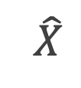
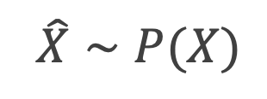
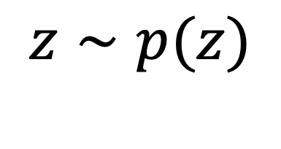
Variational Auto Encoder as a generative model
Generative model
$$z∼p(z)$$
$$Z$$
$$\hat{X}$$
$$\hat{X}∼P(X)$$
Though we used Variational inference to sample of the latent space, at the end we created a model that given z in generates$\hat{X}$with a distribution similar to $X.$

Slide 10
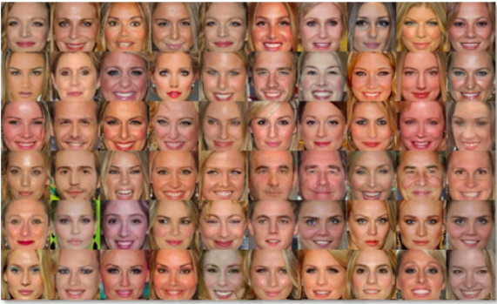
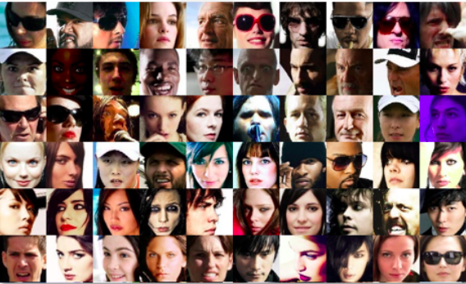
Why should we study it?
Realistic generation tasks
Debiasing and data augmentation
Missing data
Simulation and planning (RL)
[MIT 6.S191: Introduction to Deep Learning]

Slide 11
Outline
Generative Modeling Motivation
High Level Formalism
Architecture
Mathematics
Training GANS
Conditional GANS

Slide 12




Generative Adversarial Networks (GANs)
Mary
Marketer
Filip
Spam Filterer
Yes, it is spam
Spam
No, it is not spam

Slide 13



Generative Adversarial Networks (GANs)
Discards a valid email
Filip
Spam
Spam
Spam
Yes, it is spam
Spam
Spam
Spam
No, it is not spam
Allowed some spams

Slide 14
Generative Adversarial Networks (GANs)
Mary and Filip
learned from what went wrong from their perspective
It was spam, for real
It was not spam
Spam
Spam
Filip: it is spam
Spam
Spam
Filip: it is not spam
Spam
Spam

Slide 15
Generative Adversarial Networks (GANs)
Mary and Filip
learned from what went wrong from their perspective
It was spam, for real
It was not spam
Spam
Spam
Filip: it is spam
Spam
Spam
Filip: it is not spam
Spam
Spam

Slide 16
Generative Adversarial Networks (GANs)
Filip
Learns what typical words a spam email contains
Mary
Finds more sophisticated words to use
Yes, it is spam
No, it is not spam

Slide 17
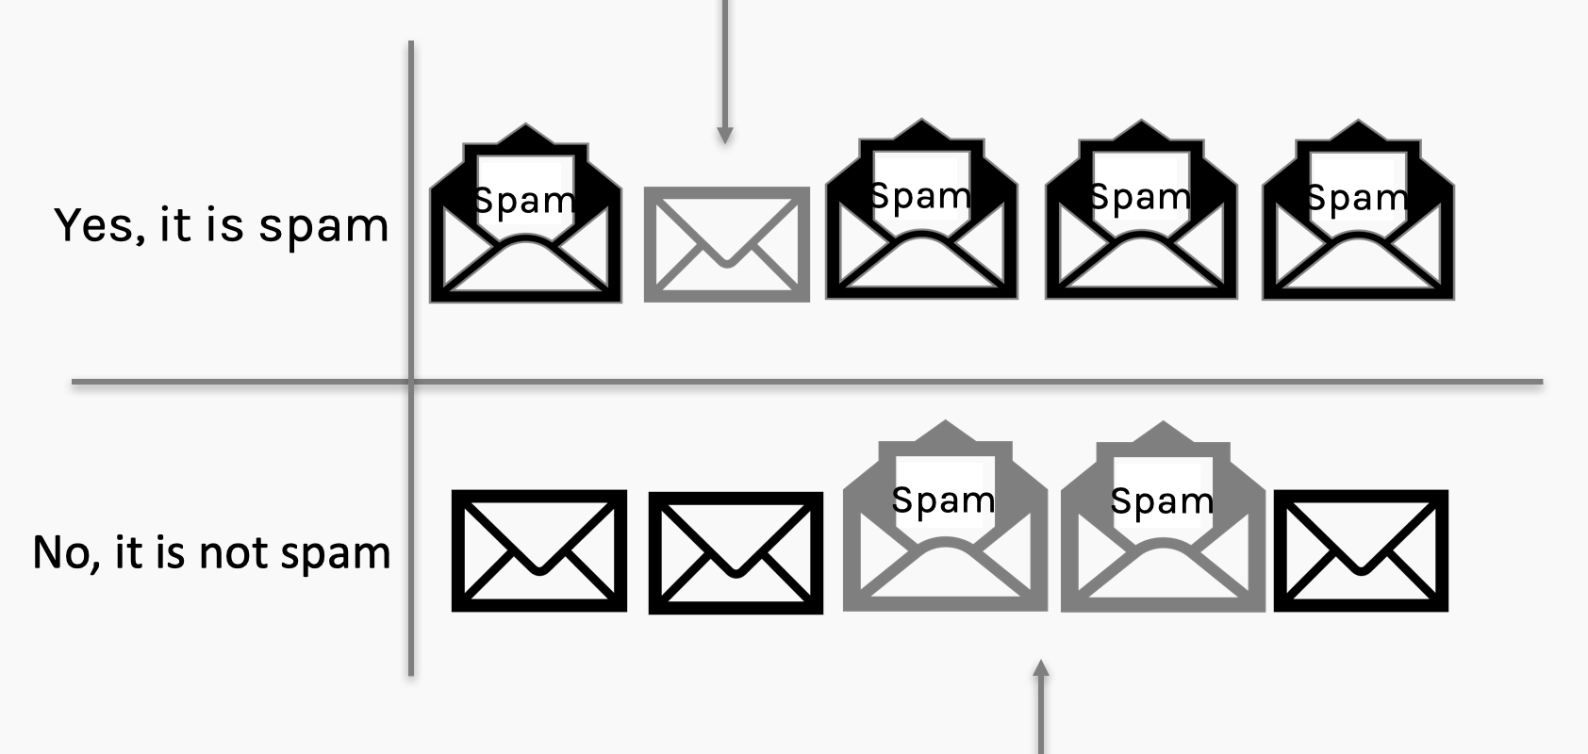

Generative Adversarial Networks (GANs)
Discarded a valid email
Yes, it is spam
No, it is not spam
Allowed fewer spams

Slide 18
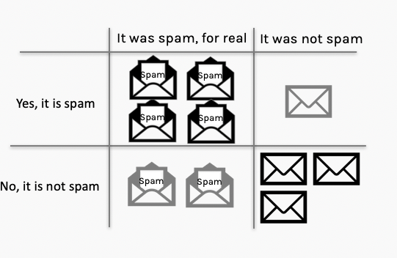
Generative Adversarial Networks (GANs)
Mary and Filip
learned from what went wrong from their perspective
It was spam, for real
It was not spam
Filip: it is spam
Filip: it is not spam

Slide 19

Generative Adversarial Networks (GANs)
Adversaries: Mary and Filip
Mary
Generator
Filip
Discriminator

Slide 20
Generative Adversarial Networks (GANs)
Understanding confusion matrix
TRUE/FALSE: If prediction and true label match / do not match
POSITIVE/NEGATIVE: Prediction class (SPAM = POSITIVE)
SPAM/NON SPAM
label: POSITIVE/NEGATIVE
True Label
Prediction
False Positive
Pos
Neg
Positive
TP
FP
M
prediction matches label?
Yes: True
+
=
prediction
Negative
FN
TN
No: False

Slide 21
Generative Adversarial Networks (GAN)
TRUE/FALSE: If prediction and true label match / do not match
POSITIVE/NEGATIVE: Prediction class (SPAM = POSITIVE)
TP
FP
label: it is a spam
FN
TN
D
prediction matches label?
Yes
No action for discriminator. Generator must do better.
prediction:
yes, it is spam
Show email
POSITIVE
It was spam, for real
It was not spam
Yes, it is spam
True positive (TP): the discriminator sees a spam and predicts correctly. No need for further actions for discriminator. Generator must do a better job.
No, it is not spam

Slide 22
Generative Adversarial Networks (GANs)
TRUE/FALSE: If prediction and true label match / do not match
POSITIVE/NEGATIVE: Prediction class (SPAM = POSITIVE)
TP
FP
label: it is a spam
FN
TN
NEGATIVE
prediction matches label?
D
prediction:
No, It is NOT a spam
show email
No
It was spam, for real
It was not spam
Discriminator learns more about spams.
Yes, it is spam
False Negative (FN): the discriminator sees an email and predicts it not a spam even though it is. The discriminator must learn more.
No, it is not spam

Slide 23
Generative Adversarial Networks (GANs)
TP
FP
label: it is not a spam
FN
TN
D
prediction matches label?
prediction:
Yes. it is a spam
show email
POSITIVE
No
Discriminator learns more about spams.
It was spam, for real
It was not spam
Yes, it is spam
False Positive (FP): the discriminator sees an email and predicts it is a spam even though it is NOT. The discriminator must learn more.
No, it is not spam
TRUE/FALSE: If prediction and true label match / do not match
POSITIVE/NEGATIVE: Prediction class (SPAM = POSITIVE)

Slide 24
Generative Adversarial Networks (GANs)
TRUE/FALSE: If prediction and true label match / do not match
POSITIVE/NEGATIVE: Prediction class (SPAM = POSITIVE)
TP
FP
label: it is not a spam
FN
TN
NEGATIVE
prediction matches label?
YES
D
No action
prediction:
No, it is not a spam
Show spam email
It was spam, for real
It was not spam
Yes, it is spam
True negative (TN): No action required by Generator or Discriminator.
No, it is not spam

Slide 25
Generative Adversarial Networks (GANs)
Adversaries: Mary and Filip
Mary
Generator
Filip
Discriminator

Slide 26
Generative Adversarial Networks (GANs)
Adversaries: Mary and Filip
Become: Two player game between a generator G and a discriminator D.
Discriminator
Generator

Slide 27

Why is it a “game” ?

Slide 28
Outline
Generative Modeling Motivation
High Level Formalism
Architecture
Mathematics
Training GANS
Conditional GANS

Slide 29
The Discriminator
The discriminator is very simple. It takes a sample as input, and its output is a single value that reports the network’s probability that the input is from the training set rather than being a fake.
There are not many restrictions on what the discriminator is.
probability that sample is real
Discriminator
sample

Slide 30
The Generator
The generator takes as input a bunch of random numbers and generates a sample.
If we build our generator to be deterministic, then the same input will always produce the same output.
We want to generate data from a distribution. In that sense, we can think of the input values as latent variables.
sample
Generator
noise

Slide 31
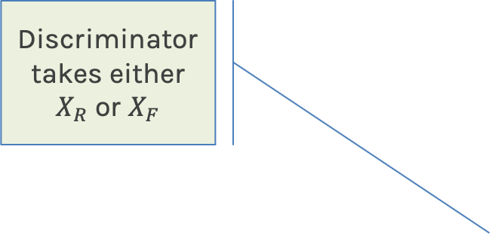
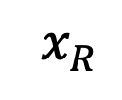
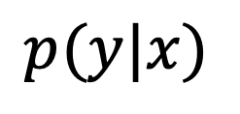
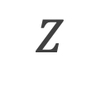
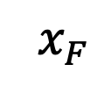
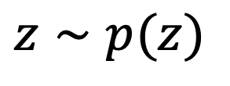
GANS Architecture
Discriminator takes either $X_{R}$ or $X_{F}$
Real data
$$x_{R}$$
Discriminator
Generator
$$p(y|x)$$
Classification
$$Z$$
$$x_{F}$$
$$z∼p(z)$$
Fake data

Slide 32
Outline
Generative Modeling Motivation
High Level Formalism
Architecture
Mathematics
Training GANS
Conditional GANS

Slide 33
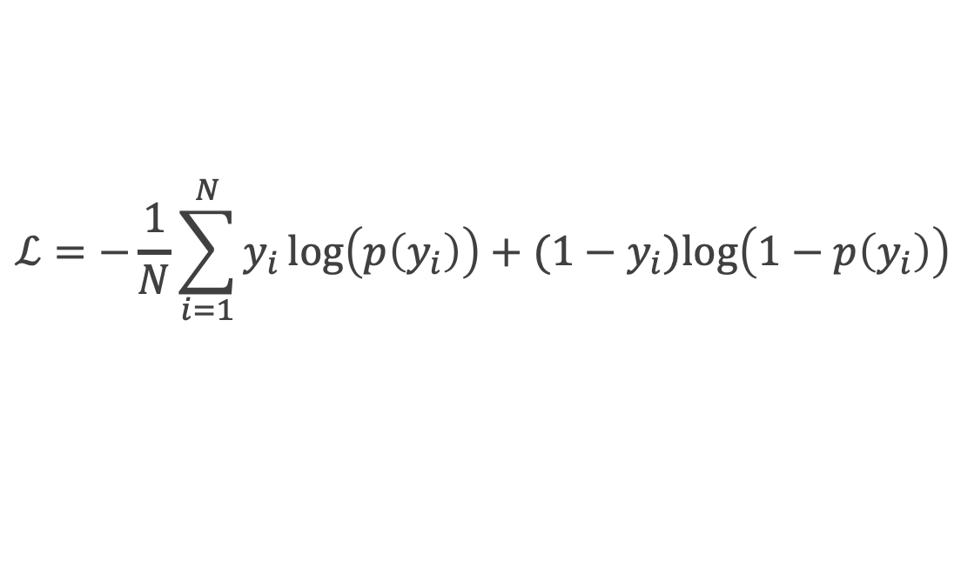
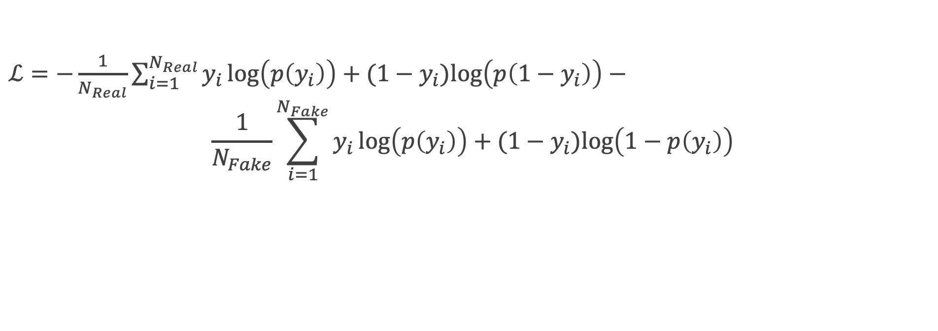
Training: Loss Function
In a binary classification problem, the loss function is given by:
$$ℒ=−\frac{1}{N}\sum_{i=1}^{N}{y_{i}}\log\left(p\left(y_{i}\right)\right)+{(1−y}_{i})log\left(1−p\left(y_{i}\right)\right)$$
Where 𝑦 is the label for 𝑟𝑒𝑎𝑙=1 or f𝑎𝑘𝑒=0. The input to the Discriminator can be the real data or the fake data generated by the Generator. Splitting the loss function, we have:
$ℒ=−\frac{1}{N_{Real}}\sum_{i=1}^{N_{Real}}{y_{i}}\log\left(p\left(y_{i}\right)\right)+{(1−y}_{i})log\left(p\left(1−y_{i}\right)\right)$ $−$
$$\frac{1}{N_{Fake}}\sum_{i=1}^{N_{Fake}}{y_{i}}\log\left(p\left(y_{i}\right)\right)+{(1−y}_{i})log\left(1−p\left(y_{i}\right)\right)$$

Slide 34



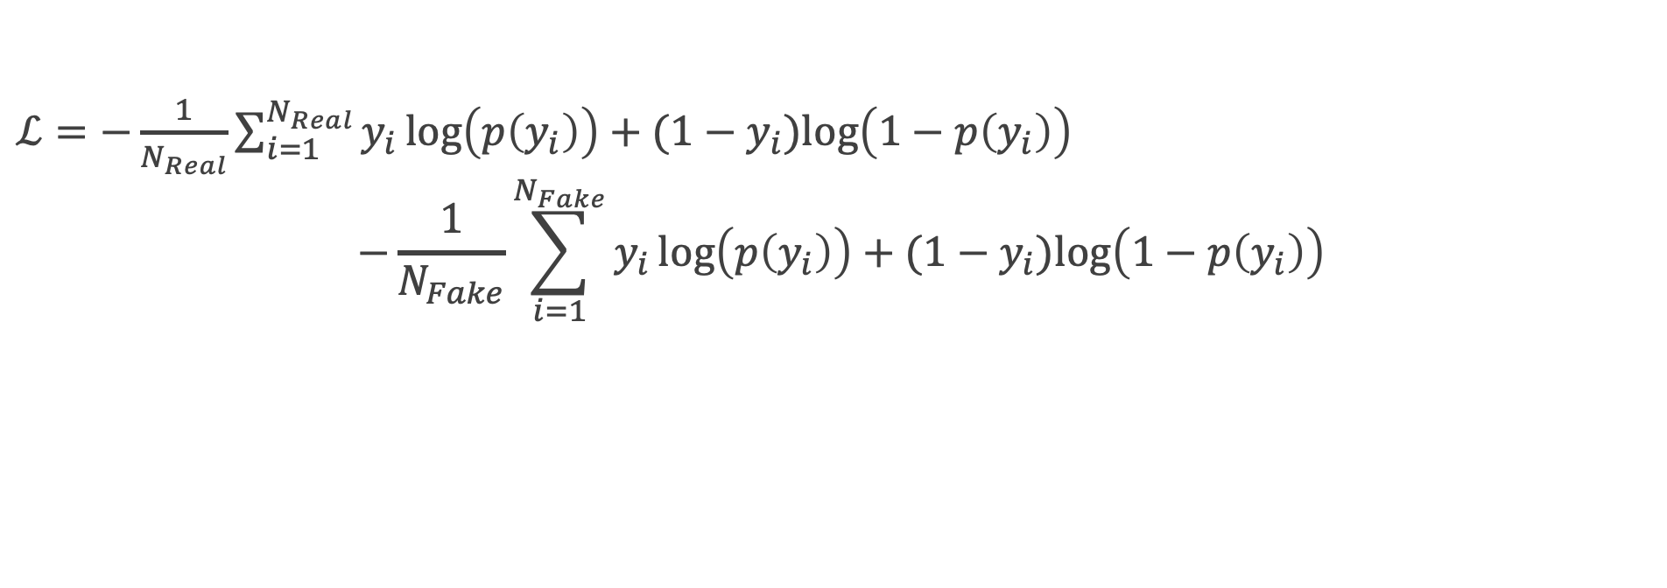
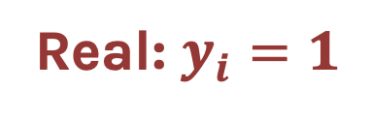
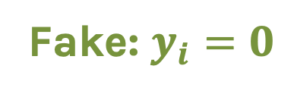
Learning
Real: $y_{i}=1$
$ℒ=−\frac{1}{N_{Real}}\sum_{i=1}^{N_{Real}}{y_{i}}\log\left(p\left(y_{i}\right)\right)+{(1−y}_{i})log\left(1−p\left(y_{i}\right)\right)$
$$−\frac{1}{N_{Fake}}\sum_{i=1}^{N_{Fake}}{y_{i}}\log\left(p\left(y_{i}\right)\right)+{(1−y}_{i})log\left(1−p\left(y_{i}\right)\right)$$
Fake: $y_{i}=0$

Slide 35
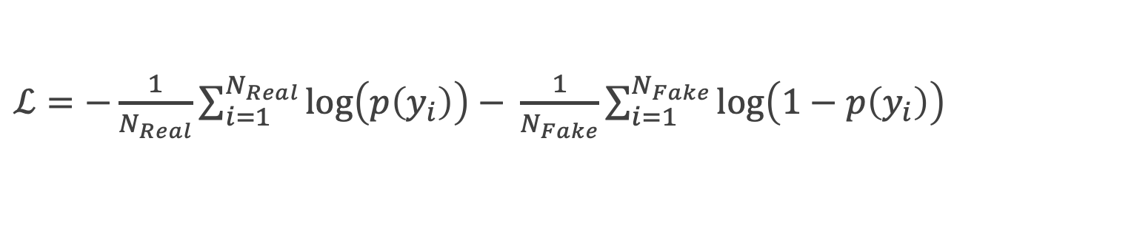
Learning
$ℒ=−\frac{1}{N_{Real}}\sum_{i=1}^{N_{Real}}{\log\left(p\left(y_{i}\right)\right)}$ $− \frac{1}{N_{Fake}}\sum_{i=1}^{N_{Fake}}{\log\left(1−p\left(y_{i}\right)\right)}$

Slide 36
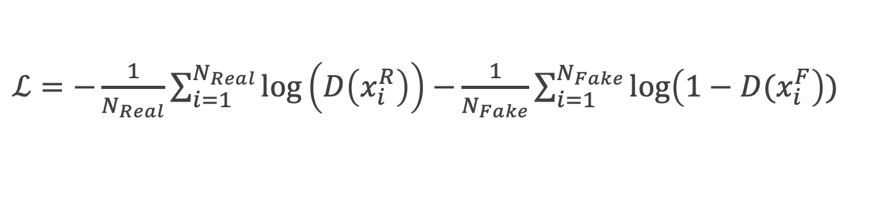
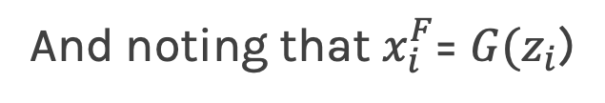
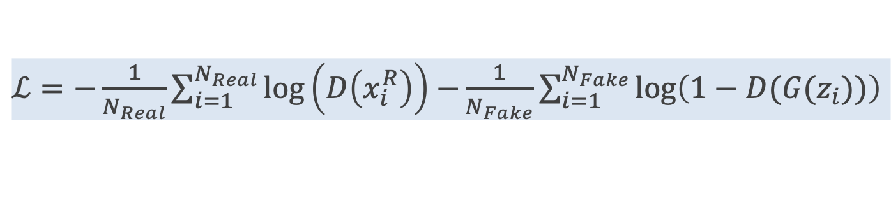
Learning
$ℒ=−\frac{1}{N_{Real}}\sum_{i=1}^{N_{Real}}{\log\left(p\left(y_{i}\right)\right)}$ $− \frac{1}{N_{Fake}}\sum_{i=1}^{N_{Fake}}{\log\left(1−p\left(y_{i}\right)\right)}$
Rewriting in terms of discriminator D and generator G outputs:
$ℒ=−\frac{1}{N_{Real}}\sum_{i=1}^{N_{Real}}{\log\left(D\left(x_{i}^{R}\right)\right)}$ $−\frac{1}{N_{Fake}}\sum_{i=1}^{N_{Fake}}{\log\left(1−D(x_{i}^{F}\right))}$
And noting that $x_{i}^{F}$= $G(z_{i}$)
$ℒ=−\frac{1}{N_{Real}}\sum_{i=1}^{N_{Real}}{\log\left(D\left(x_{i}^{R}\right)\right)}$ $−\frac{1}{N_{Fake}}\sum_{i=1}^{N_{Fake}}{\log\left(1−D(G(z_{i}))\right)}$

Slide 37
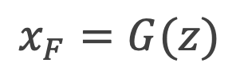
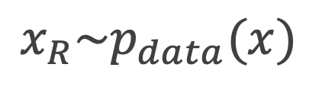
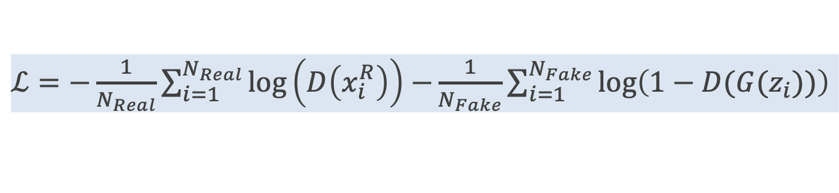
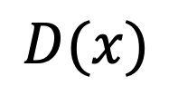
$ℒ=−\frac{1}{N_{Real}}\sum_{i=1}^{N_{Real}}{\log\left(D\left(x_{i}^{R}\right)\right)}$ $−\frac{1}{N_{Fake}}\sum_{i=1}^{N_{Fake}}{\log\left(1−D(G(z_{i}))\right)}$
$$x_{R}\sim p_{data}(x)$$
$$x_{R}$$
Discriminator
$$D(x)$$
Generator
$$p(y|x)$$
Classification
$$Z$$
$$x_{F}$$
$$z∼p(z)$$
$$x_{F}=G(z)$$
${ℒ=−Ε}_{x\sim p_{data}(x)}\left[log⁡(D(x))\right]$ - $Ε_{z\sim p_{z}(z)}\left[log⁡(1 − D(G(z))\right]$
37

Slide 38
Learning
${ℒ=−Ε}_{x\sim p_{data}(x)}\left[log⁡(D(x))\right]$ - $Ε_{z\sim p_{z}(z)}\left[log⁡(1 − D(G(z))\right]$
The adversarial training can be described as though the Generator G and Discriminator D play the following two-player min-max game with the following value function V (G, D).
The Discriminator’s job is to minimize the loss or maximize the –ve loss.
The Generator’s job is to maximize the loss or minimize the –ve loss.
$\max_{D}V\left(G,D\right)=Ε_{x\sim p_{data}(x)}\left[log⁡(D(x))\right]$ + $Ε_{z\sim p_{z}(z)}\left[log⁡(1 − D(G(z))\right]$
$\min_{G}{\max_{D}{V\left(G,D\right)}}=Ε_{x\sim p_{data}(x)}\left[log⁡(D(x))\right]$ + $Ε_{z\sim p_{z}(z)}\left[log⁡(1 − D(G(z))\right]$

Slide 39
Discriminator’s prediction on fake data
Minimax value function
Discriminator’s prediction on real data
Sample random noise
Sample real data
Generator’s output:
fake data

Slide 40
Minimax value function
Discriminator:
Maximize
Generator:
Minimize

Slide 41
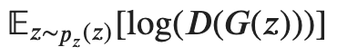
Minimax value function
Discriminator:
Maximize
Generator:
Maximize

Slide 42
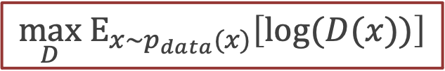
Training the GAN
$${\max_{D} Ε}_{x\sim p_{data}(x)}\left[log⁡(D(x))\right]$$
False negative (I: Real/D: Fake):
In this case we feed reals to the discriminator. The Generator is not involved in this step at all.
The error function here only involves the Discriminator and if it makes a mistake the error drives a backpropagation step through the discriminator, updating its weights, so that it will get better at recognizing reals.
Error
Function
Update
Fake
Discriminator
Real
Reals

Slide 43
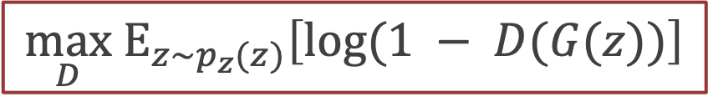
Training the GAN
$${\max_{D} Ε}_{z\sim p_{z}(z)}\left[log⁡(1 − D(G(z))\right]$$
Error
Function
Update
False positives (I:Fake/D:Real):
Here we generate a fake and punish the discriminator if it classifies it as real.
Real
Discriminator
Fake
Generator
noise

Slide 44
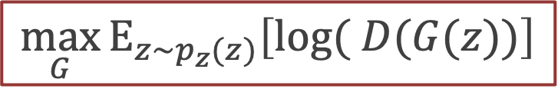
Training the GAN
$${\max_{G}⁡Ε}_{z\sim p_{z}(z)}\left[log⁡( D(G(z))\right]$$
Error
Function
True negative (I: Fake/D: Fake):
We start with random numbers going into the generator.
The generator’s output is a fake.
The objective function gets a large –ve value if this fake is correctly identified as fake. Meaning that the generator got caught.
Backprop, goes through the discriminator (which is frozen) to the generator updating the generator’s weight, so it can better learn how to fool the discriminator.
Fake
Discriminator
Update
Fake
Generator
noise

Slide 45
Learning
The process – known as Learning Round - accomplishes three jobs:
The discriminator learns to identify features that characterize a real sample
The discriminator learns to identify features that reveal a fake sample
The generator learns how to avoid including the features that the discriminator has learned to spot

Slide 46
Outline
Generative Modeling Motivation
High Level Formalism
Architecture
Mathematics
Training GANS
Conditional GANS

Slide 47
The Generator
Generator
Noise
Generated distribution
(FAKE)

Slide 48
Training GANs
Forward Pass
Generator
Noise
Generated distribution
(FAKE)

Slide 49
Training GANs
Forward Pass
Target distribution
(REAL)
Generator
Noise
Generated distribution
(FAKE)

Slide 50
Training GANs
Forward Pass
Target distribution
(REAL)
Discriminator
Generator
Noise
Generated distribution
(FAKE)

Slide 51
Training GANs
Forward Pass
Target distribution
(REAL)
Discriminator
Generator
Real vs. Fake Classification
Noise
Generated distribution
(FAKE)

Slide 52
Training GANs
Forward Pass
Target distribution
(REAL)
Discriminator Loss
Discriminator
Generator
Real vs. Fake Classification
Noise
Generated distribution
(FAKE)

Slide 53
Training GANs
Forward Pass
Target distribution
(REAL)
Discriminator Loss
Discriminator
Generator
Real vs. Fake Classification
Noise
Generated distribution
(FAKE)
Generator Loss

Slide 54
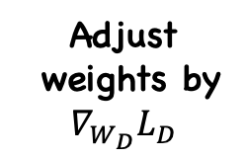
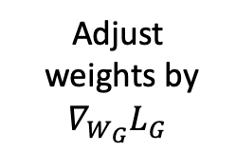
Training GANs
Backward Pass
Target distribution
(REAL)
Adjust
weights by
$$∇_{W_{D}}L_{D}$$
Discriminator Loss
Discriminator
Generator
Real vs. Fake Classification
Noise
Generated distribution
(FAKE)
Adjust
weights by
$$∇_{W_{G}}L_{G}$$
Generator Loss

Slide 55
Training GANs
Backward Pass
Target distribution
(REAL)
Adjust
weights by
$$∇_{W_{D}}L_{D}$$
Discriminator Loss
Discriminator
Generator
Real vs. Fake Classification
Noise
Generated distribution
(FAKE)
Adjust
weights by
$$∇_{W_{G}}L_{G}$$
Generator Loss

Slide 56
Training GANs
Backward Pass
Target distribution
(REAL)
Adjust
weights by
$$∇_{W_{D}}L_{D}$$
Discriminator Loss
Discriminator
Generator
Real vs. Fake Classification
Noise
Generated distribution
(FAKE)
Adjust
weights by
$$∇_{W_{G}}L_{G}$$
Generator Loss

Slide 57
Training GANs
Backward Pass
Target distribution
(REAL)
Adjust
weights by
$$∇_{W_{D}}L_{D}$$
Discriminator Loss
Discriminator
Generator
Real vs. Fake Classification
Noise
Generated distribution
(FAKE)
Adjust
weights by
$$∇_{W_{G}}L_{G}$$
Generator Loss

Slide 58
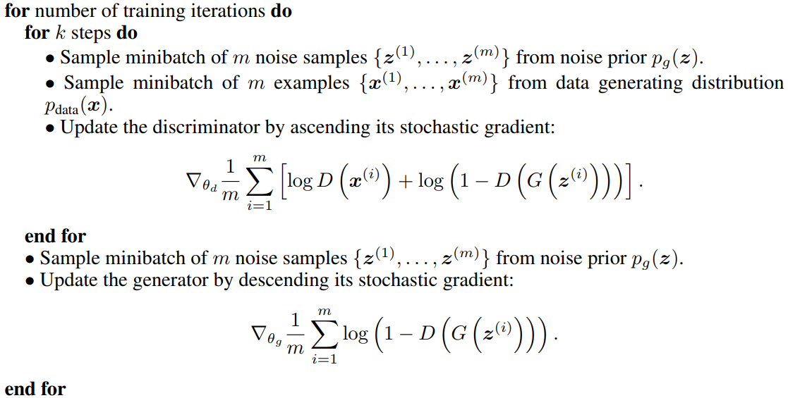
Generative Adversarial Networks
Training procedure

Slide 59
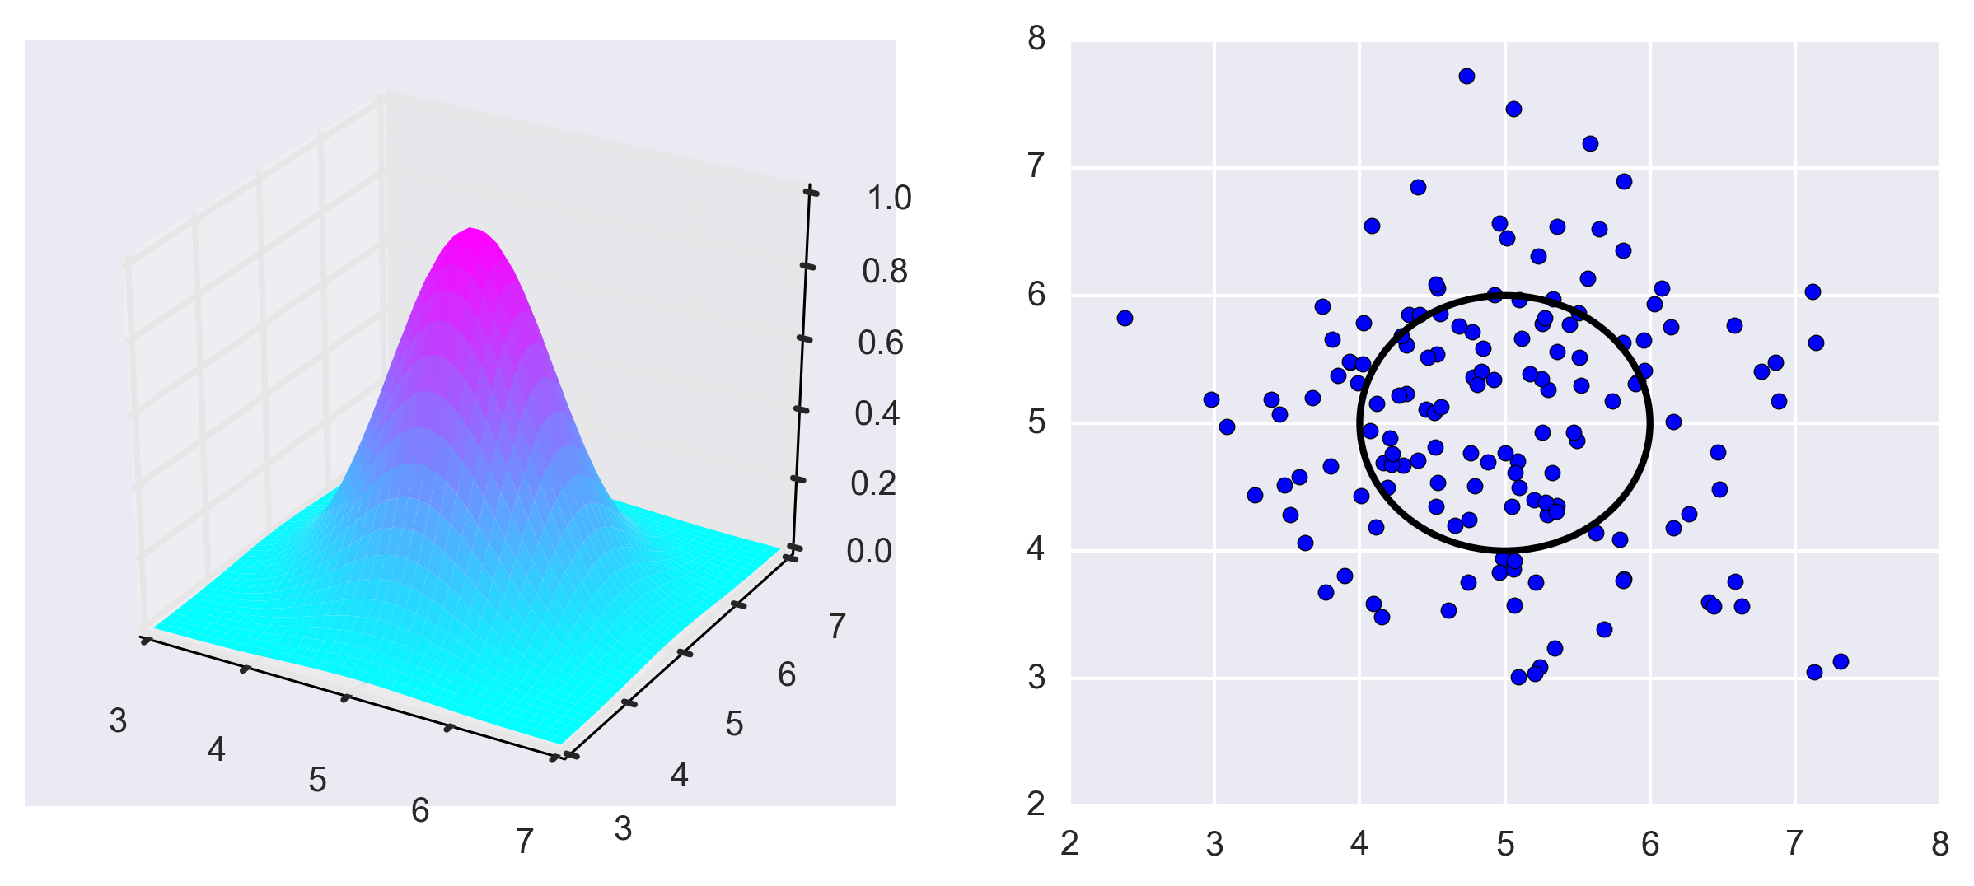
Building GANS: Fully Connected Case
16 neurons
ReLU
Dropout 0.1
16 neurons
Linear
16 neurons
ReLU
Dropout 0.1
16 neurons
ReLU
Dropout 0.1
1 neurons
Sigmoid
4 noise
1
Let’s build a FC simple GAN to generate points from a 2-dimensional Gaussian Distribution.
Generator
Takes 4 random numbers
Generates a coordinate pair
Discriminator
Takes an input point in the form of a coordinate pair
Determines whether the point is drawn from a specific 2-D Gaussian

Slide 60
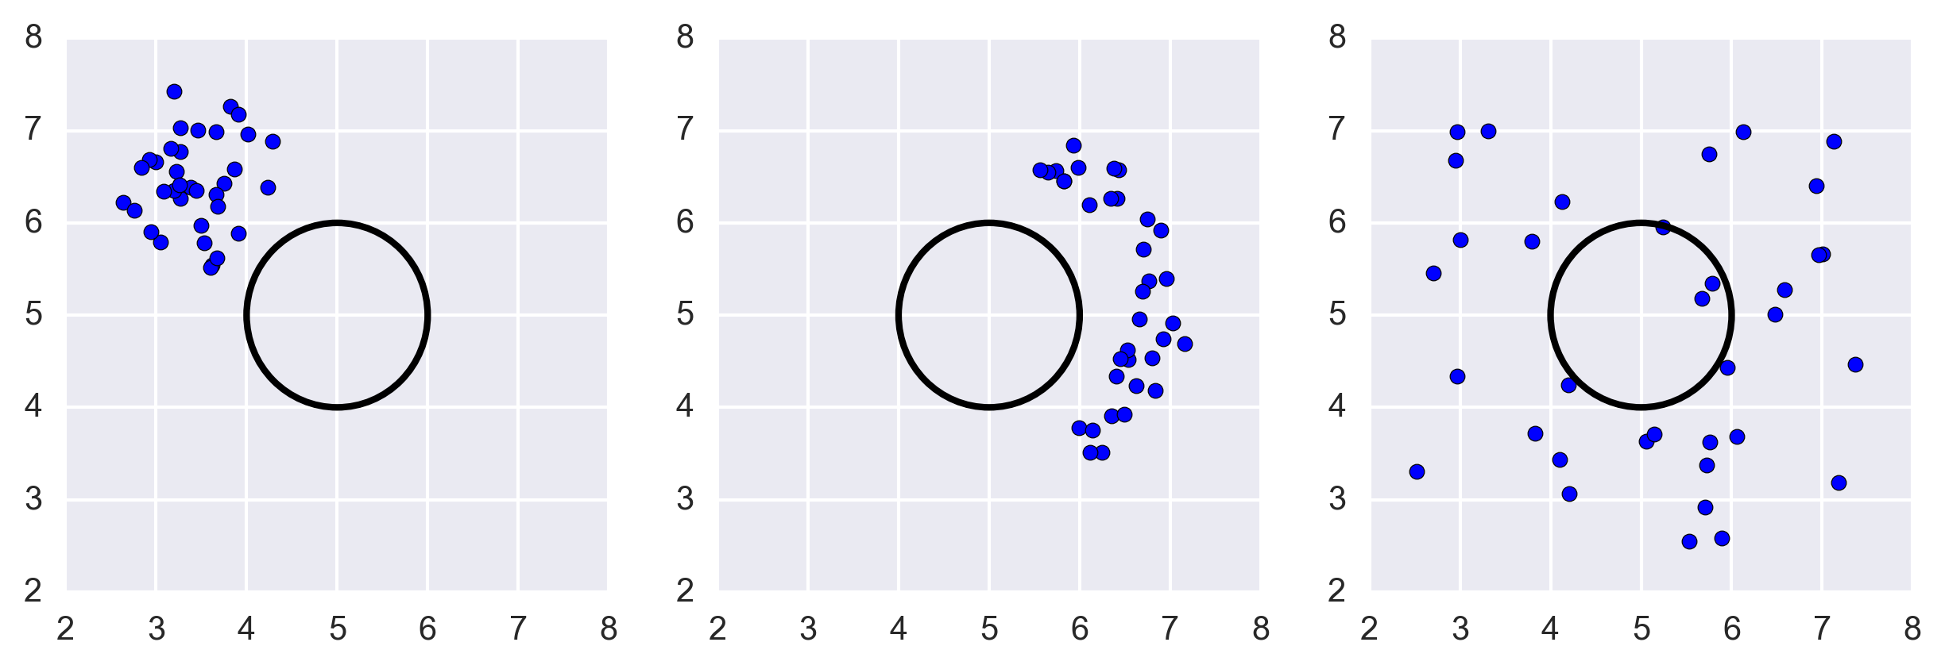
Building GANS: Fully Connected Case
Train the Networks based on their ability to generate/discriminate batches of points drawn from the distribution.
Are these batches of points drawn from the right distribution?

Slide 61
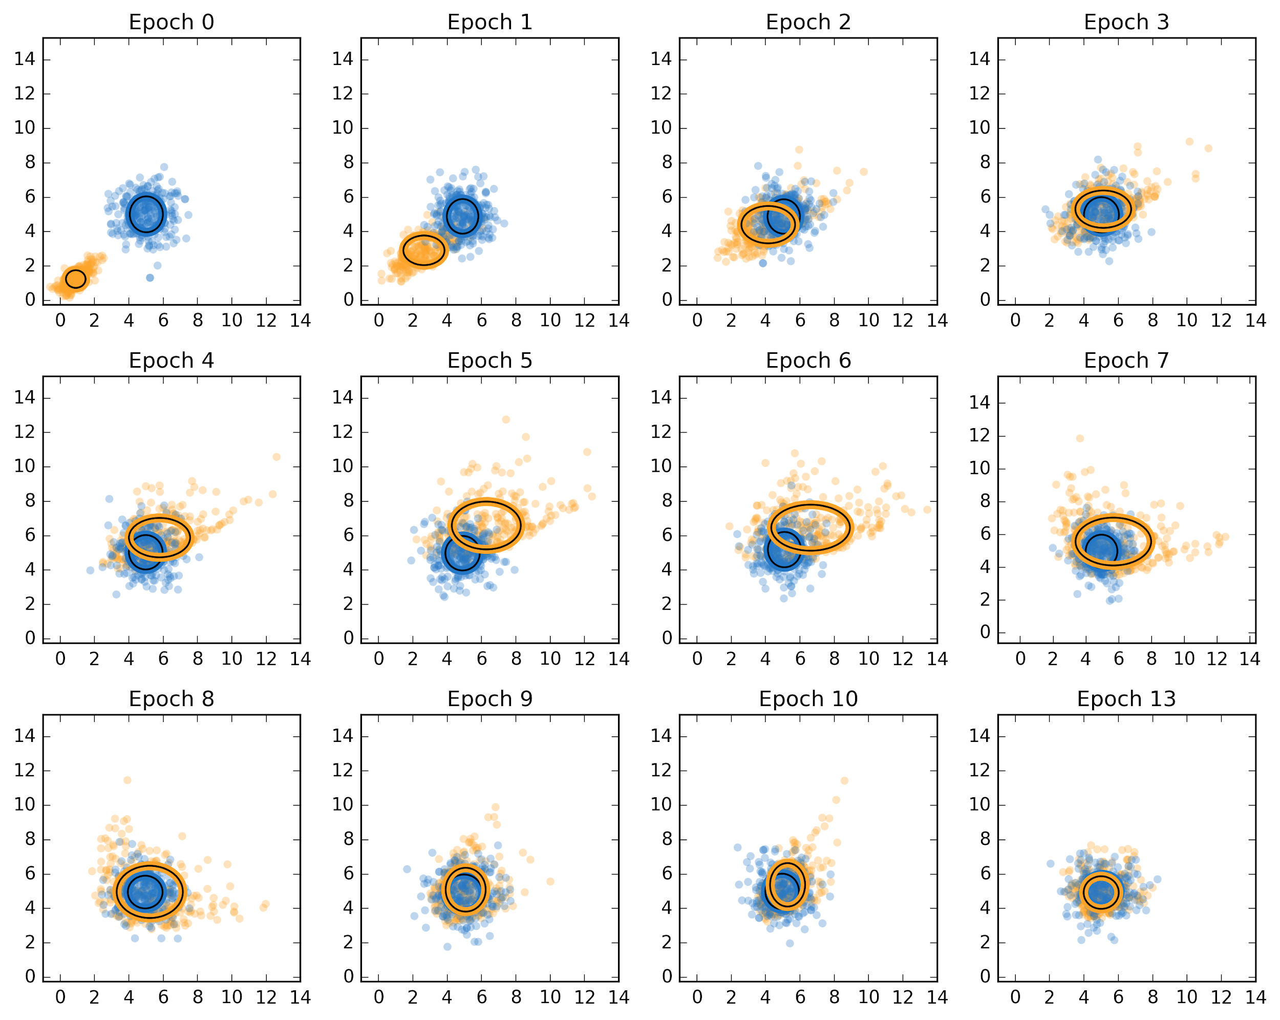
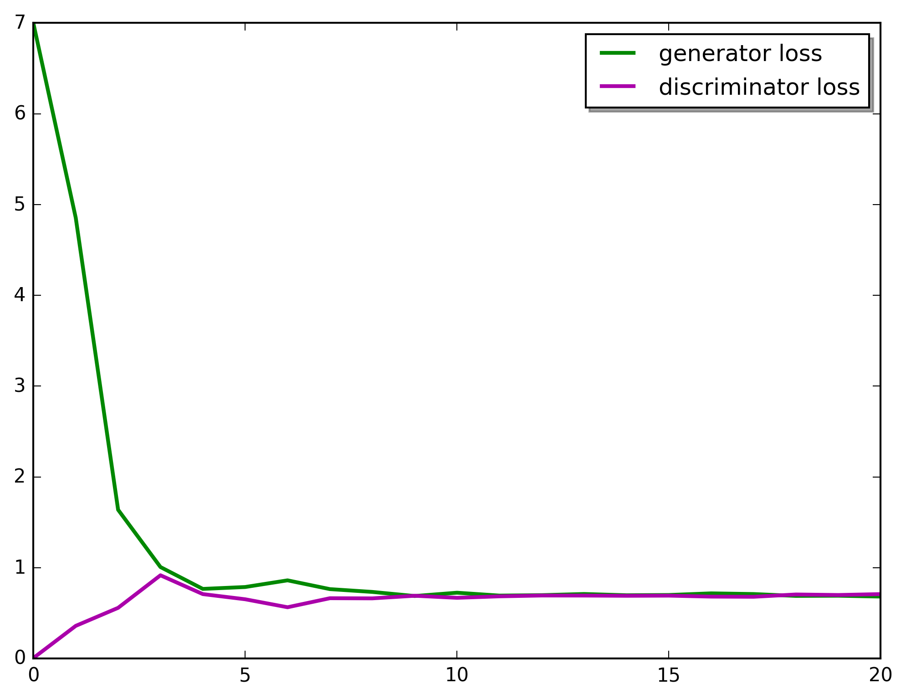
Building GANS: Fully Connected Case
As the generator and discriminator loss converges, the batch of points generated by the generator (in the yellow) approaches the real batch of points (in the blue)

Slide 62
Exercise: In this exercise, we are going to generate 1-D Gaussian distribution from a n-D uniform distribution. This is a toy exercise in order to understand the ability of GANs (generators) to generate arbitrary distributions from random noise.

Slide 63
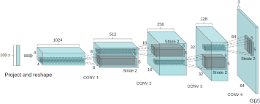
Deep Convolutional GAN: DCGAN
Deep Convolutional GAN (DCGAN) -- Alex Radford et al. 2016
Eliminate fully connected layers.
Max Pooling BAD! Replace all max pooling with convolutional stride
Use transposed convolution for upsampling or simply upsampling.
Use Batch normalization

Slide 64
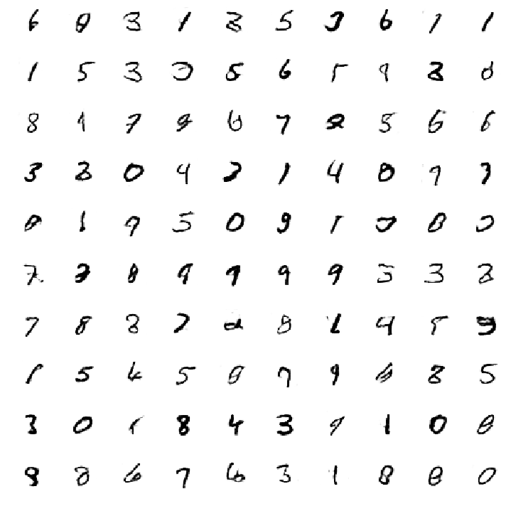
Building GANS: DCGAN
DCGAN on MNIST
Generated digits

Slide 65

Building GANS: DCGAN
DCGAN Interpretable Vector Arithmetic
Parallels to Autoencoder Case
https://arxiv.org/pdf/1511.06434v2.pdf

Slide 66

Evolution of GANs
5 Years of Improvement in Artificially Generated Faces
2021
https://twitter.com/goodfellow_ian/status/969776035649675265?lang=en

Slide 68

Evolution of GANs

Slide 69
Outline
Generative Modeling Motivation
High Level Formalism
Architecture
Mathematics
Training GANS
Conditional GANS

Slide 70






Vanilla Generative Adversarial Nets
$$x_{R}\sim p_{data}(x)$$
$$x_{R}$$
Discriminator
Generator
$$D(x)$$
$$p(y|x)$$
$$z∼p(z)$$
Classification
$$Z$$
$$x_{F}$$
$$x_{F}=G(z)$$
70

Slide 71





Conditional Generative Adversarial Nets
$$x_{R}\sim p_{data}(x|θ)$$
$$x_{R}$$
Discriminator
Generator
$$D(x|θ)$$
$$p(y|x, θ)$$
$$z∼p(z)$$
Classification
$$Z$$
$$x_{F}$$
$$x_{F}=G(z|θ)$$
Conditional GANs are an extension of the GANs model. The Generator and Discriminator both receive some additional conditioning input information. This could be the class of the current image or some other property.
$$θ$$
Conditions
https://arxiv.org/abs/1411.1784
71

Slide 72






Conditional Generative Adversarial Nets
Generator
$$z∼p(z)$$
$$Z$$
$$x_{F}$$
$$θ$$
$$x_{F}=G(z|θ)$$
Conditions
72

Slide 73
Next Lecture
Challenges
Mode Collapse
Evaluate GANs
Auxiliary Classifier
Wasserstein GAN
Self-Attention Generative Adversarial Networks
Large Scale GAN Training for High Fidelity Natural Image Synthesis

